Slide 1
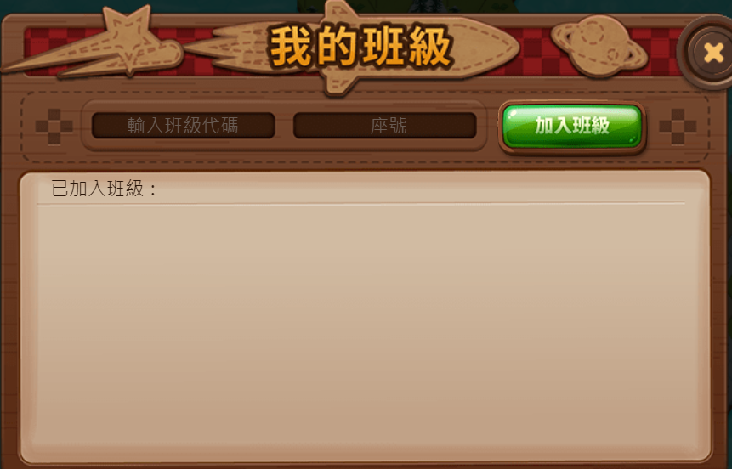
9HGKXK
00
9HGKXK

Slide 2
GGD46Z
00
GGD46Z

